Slide 1
SOFTWARE METRICS

Slide 2
CONTENTS
Software Metrics:
Size Metrics like LOC, Token Count, Function Count

Slide 3
Software Metrics
Software Metrics: What and Why ?
1. How to measure the size of a software?
2. How much will it cost to develop a software?
3. How many bugs can we expect?
4. When can we stop testing?
5. When can we release the software?
6. What is the complexity of a module?
7. What is the module strength and coupling?
8. What is the reliability at the time of release?
9. Which test technique is more effective?
10. Are we testing hard or are we testing smart?
11. Do we have a strong program or a week test suite?

Slide 4
Pressman explained as “A measure provides a quantitative indication of the extent, amount, dimension, capacity, or size of some attribute of the product or process”.
Measurement is the act of determine a measure
The metric is a quantitative measure of the degree to which a system, component, or process possesses a given attribute.
Fenton defined measurement as “ it is the process by which numbers or symbols are assigned to attributes of entities in the real world in such a way as to describe them according to clearly defined rules”.
Definition
Software metrics can be defined as “The continuous application of measurement based techniques to the software development process and its products to supply meaningful and timely management information, together with the use of those techniques to improve that process and its products”.

Slide 5
Areas of Applications
The most established area of software metrics is cost and size estimation techniques.
The prediction of quality levels for software, often in terms of reliability, is another area where software metrics have an important role to play.
The use of software metrics to provide quantitative checks on software design is also a well established area.

Slide 6
Problems During Implementation
Statement : Software development is to complex; it cannot be managed
like other parts of the organization.
Management view : Forget it, we will find developers and managers who
will manage that development.
Statement : I am only six months late with project.
Management view : Fine, you are only out of a job.
Statement : But you cannot put reliability constraints in the contract.
Management view : Then we may not get the contract.

Slide 7
Categories of Metrics
Product metrics: describe the characteristics of the product such as size, complexity, design features, performance, efficiency, reliability, portability, etc.
ii. Process metrics: describe the effectiveness and quality of the processes that produce the software product. Examples are:
• effort required in the process
• time to produce the product
• effectiveness of defect removal during development
• number of defects found during testing
• maturity of the process

Slide 8
iii. Project metrics: describe the project characteristics
and execution. Examples are :
• number of software developers
• staffing pattern over the life cycle of the software
• cost and schedule
• productivity

Slide 9
Types of Measures
• Direct Measures (internal attributes)
– Cost, effort, LOC, speed, memory
• Indirect Measures (external attributes)
– Functionality, quality, complexity, efficiency, reliability, maintainability
OBJECTIVE :
Using numbers to improve the software or the process of developing software.
To improve management process

Slide 10
APPLICATIONS :
To estimate size and cost.
Controlling Whole Project
Prediction quality levels for software.
LINES OF CODE :
Basic idea is to estimate the size
No general agreement about what is line of code
Productivity = LOC / (person-month)
Measuring by lines of code is like measuring a building by no. of bricks used.
Lines of code can tell programming time but fail to tell about the efficiency and reliability.

Slide 11
FUNCTION COUNT :
Counting functions instead of components
Measuring functionality from user point of view
Measuring independent of technology used
INPUTS
OUTPUTS
ENQUIRIES
INTERNAL LOGIC FILES
EXTERNAL LOGIC FILES.

Slide 12
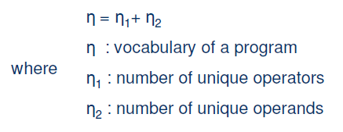
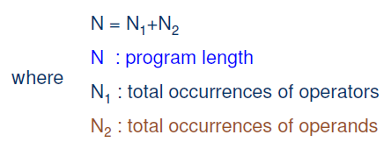
Token Count
The size of the vocabulary of a program, which consists of the number of unique tokens used to build a program is defined as:
The length of the program in the terms of the total number of tokens used is
N= 2* LOC (if each line has one operator and one operand)

Slide 13


Program Volume
The unit of measurement of volume is the common unit for size “bits”. It is the actual size of a program if a uniform binary encoding for the vocabulary is used.
Program Level
The value of L ranges between zero and one, with L=1 representing a program written at the highest possible level (i.e., with minimum size).
If L=1 ,the program is having minimum size and If L=0 the program is having maximum size.
Potential Volume : Represents program having minimal sizes
V*= (2 + n₂*) log2 (2 + n₂*)
n₂= no. of operands n₂*= no. of potential operands
Program Difficulty
As the volume of an implementation of a program increases, the program level decreases and the difficulty increases. Thus, programming practices such as redundant usage of operands, or the failure to use higher-level control constructs will tend to increase the volume as well as the difficulty.

Slide 14

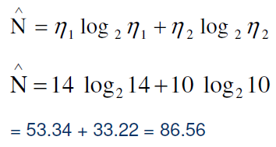

Programming Effort
The unit of measurement of E is elementary mental discriminations.
Average Program Length
The following alternate expressions have been published to estimate program length.

Slide 15
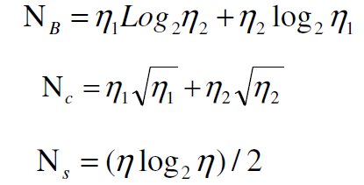
The definitions of unique operators, unique operands, total operators and total operands are not specifically delineated.

Slide 16
Counting rules for C language
1. Comments are not considered.
2. The identifier and function declarations are not considered.
3. All the variables and constants are considered operands.
4. Global variables used in different modules of the same program are counted as multiple
occurrences of the same variable.
5. Local variables with the same name in different functions are counted as unique
operands.
6. Functions calls are considered as operators.
7. All looping statements e.g., do {…} while ( ), while ( ) {…}, for ( ) {…}, all control
statements e.g., if ( ) {…}, if ( ) {…} else {…}, etc. are considered as operators.
8. In control construct switch ( ) {case:…}, switch as well as all the case statements are
considered as operators.

Slide 17
9. The reserve words like return, default, continue, break, sizeof, etc., are considered as
operators.
10. All the brackets, commas, and terminators are considered asoperators.
11. GOTO is counted as an operator and the label is counted as an operand.
12. The unary and binary occurrence of “+” and “-” are dealt separately. Similarly “*”
(multiplication operator) are dealt with separately.
13. In the array variables such as “array-name [index]” “arrayname” and “index” are
considered as operands and [ ] is considered as operator.
14. In the structure variables such as “struct-name, member-name” or “struct-name ->
member-name”, struct-name, member-name are taken as operands and ‘.’, ‘->’ are
taken as operators. Some names of member elements in different structure variables
are counted as unique operands.
15. All the hash directive are ignored.

Slide 18



Potential Volume
Estimated Program Level / Difficulty
Halstead offered an alternate formula that estimate the program level.
where

Slide 19
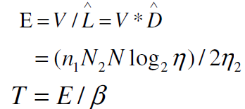

Effort and Time
is normally set to 18 since this seemed to give best results in Halstead’s earliest experiments, which compared the predicted times with observed programming times, including the time for design, coding, and testing.
Language Level
Using this formula, Halstead and other researchers determined the language level for various languages as shown in Table

Slide 20
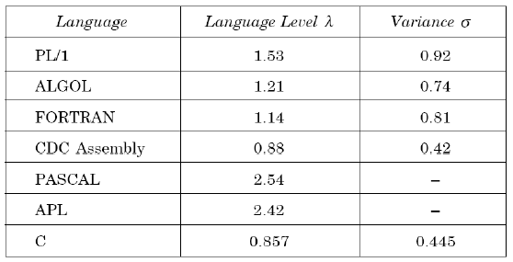
Table 1: Language Levels

Slide 21
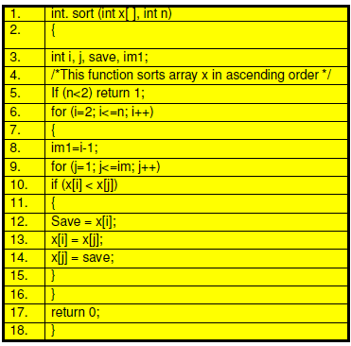
Example:1 Consider the sorting program in below Fig. List out the operators and operands and also calculate the values of software science measures like Software Metrics η, N,V, E,λ etc.

Slide 22
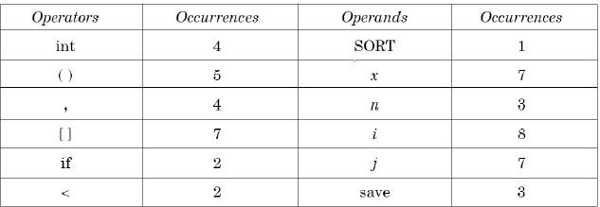
The list of operators and operands is given in table
Table 2: Operators and operands of sorting program

Slide 23
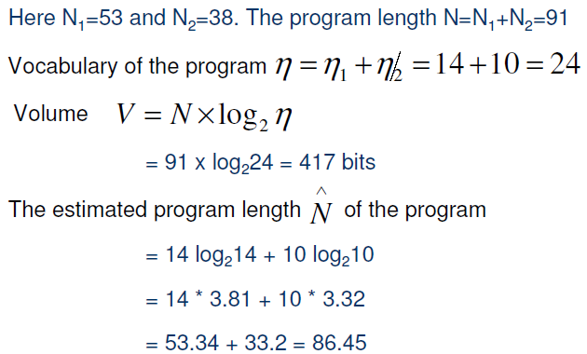

Slide 24
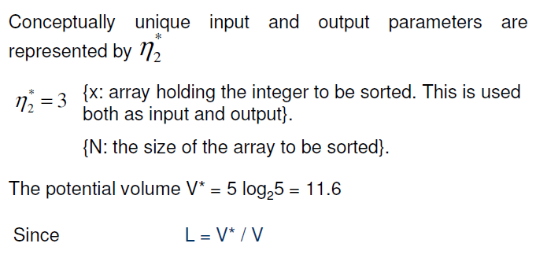

Slide 25
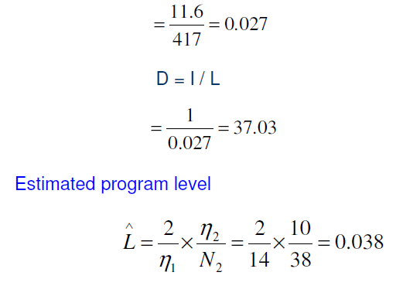

Slide 26
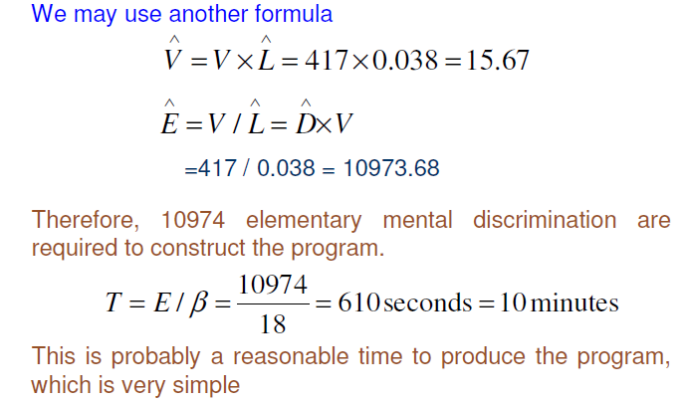

Slide 27
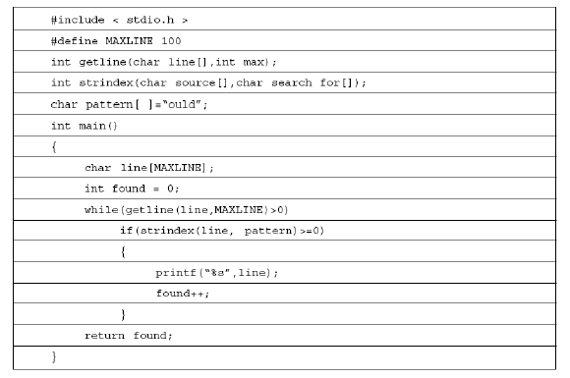
Example- 2 Consider the program shown in Table 3. Calculate the various software science metrics.
Table 3

Slide 28
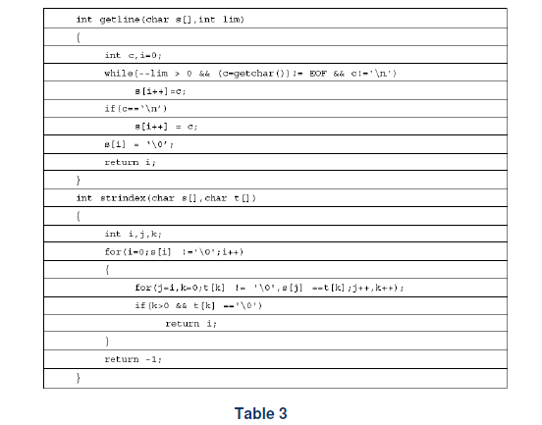

Slide 29
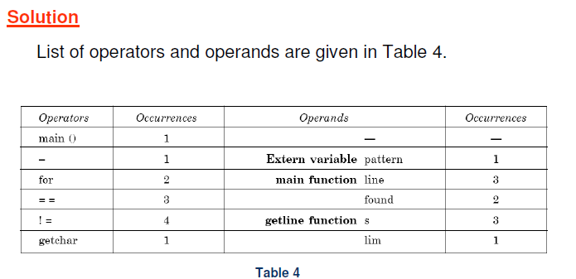

Slide 30
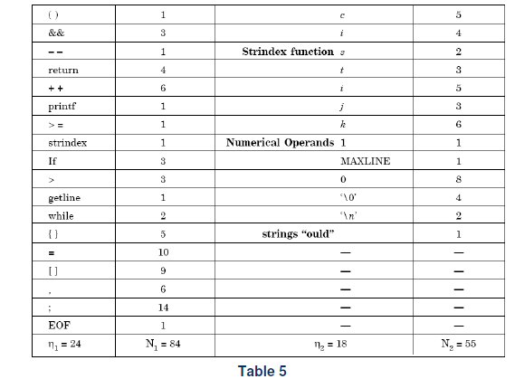

Slide 31
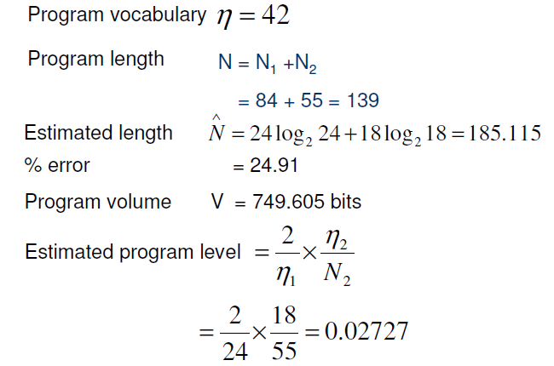

Slide 32
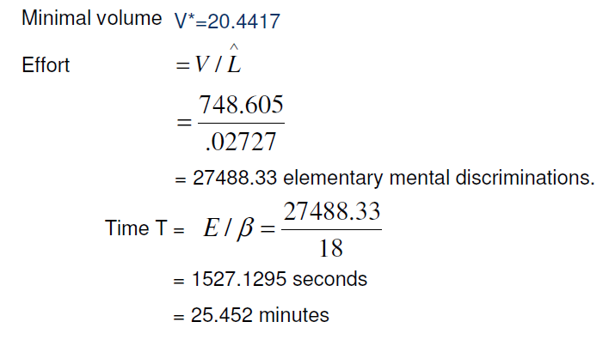

Slide 33
QUESTIONS
Q-1. Which one is not a category of software metrics ?
Product metrics
Process metrics
(c) Project metrics
(d) People metrics
Q-2. Software science measures are developed by
M.Halstead
B.Littlewood
(c) T.J.McCabe
(d) G.Rothermal

Slide 34
Q-3. In halstead theory of software science, volume is measured in bits. The
bits are
(a) Number of bits required to store the program
(b) Actual size of a program if a uniform binary encoding scheme for
vocabulary is used
(c) Number of bits required to execute the program
(d) None of the above

Slide 35
Q-4. In Halstead theory, effort is measured in
Person-months
(b) Hours
(c) Elementary mental discriminations
(d) None of the above
Q-5. Which is not a size metric?
(a) LOC
(b) Function count
(c) Program length
(d) Cyclomatic complexity

Slide 36
THANK YOU

